Slide 1
Lecture 5:
Project Planning and Estimation (1)

Slide 2
Outline
What makes a successful project?
Doing software projects
Planning software project
Project estimation:
Size
People
Resources
Notes:
Successful project
Define success
Know your entry and exit points

Slide 3
What makes a successful project?
1. People
2. Planning

Slide 4
What makes a successful project?
1. Define the project: objectives and scope
2. Build the plan: resources
– people, equipment, time, finance
Software Project Planning
(will be covered in Assignment 1)
– tasks to be performed
3. Prepare the plan
– develop a logical sequence of tasks
– develop a Gantt chart (timeline chart)
4. Run through the plan with mangers
5. Publicize the plan to participants
6. Communicate
7. Work on the project
8. Obtain updates – inspect, follow up, seek deviations from
the plan, adjust if necessary

Slide 5
Software Project Planning
The overall goal of project planning is to establish a pragmatic strategy for controlling, tracking, and monitoring a complex technical project.
Why?
So the end result gets done on time, with quality!
Notes:
Just like building a stable bridge or a house
The right parts must be assembled in the right order and right way.
This is the field of engineering.
Everything is engineered:
shelves from the store have holes in the right places

Slide 6
Project Planning Task Set-I
Establish project scope
Determine feasibility
Analyze risks
  Risk analysis is covered in detail later (chapter 25).
Define required resources
  Determine require human resources
  Define reusable software resources
  Identify environmental resources
Notes:
Scope
What you will do
Won’t do
Feasibility
Many types
Name some: Technical, financial, operational, time
Risks
Likelihood and impact
how to deal with them.

Slide 7
Project Planning Task Set-II
Estimate cost and effort
  Decompose the problem
  Develop two or more estimates using size, function points, process tasks or use-cases
  Reconcile the estimates
  Double time estimate and $$$ accordingly
Develop a project schedule
  Project scheduling will be discussed later (chapter 24)
Notes:
All these things on the last two slides are done before the analysis is begun.

Slide 8
Write it Down!
Project Scope
Estimates
Risks
Schedule
Control strategy
Software
Project
Plan

Slide 9
To Understand Scope ...
understand the customers needs
  That is, what the problem is that will be solved
understand the business context
  That is, how does this fit with the customer’s greater organizational goals.
understand the project boundaries
understand the likely paths for change
understand that ...nothing is guaranteed
Notes:
Wengbergs Furniture
Repeated the same questions in different ways

Slide 10
What is Scope?
Context.
  how does the software to be built fit into a larger system, product, or business context?
  what constraints are imposed as a result of the context?
  User types?
Information objectives.
  Who is the customer? What (customer-visible) data objects are produced as output from the software?
  What data objects are required for input?
Function and performance.
  What function does the software perform to transform input data into output?
  1. Calculation 2. Storage and retrieval, 3. Data transfer,
  Are any special performance characteristics to be addressed?
Notes:
Is the customer the buyer of the software?
Or what about the customer(s) to the buyer of the software.
Bills and Invoices….
Function and performance
Two of the keys to any function description, as will be seen in the formal documentation in the assignment, are the inputs and outputs.
Bioinformatics. I am constantly defining and redefining interfaces between input data and program functionality.
Genbank Format
FASTA format
Seded format
EID format

Slide 11
What is Scope?
Software scope identifies the boundary of the system
Software project scope must be unambiguous and understandable at the management and technical levels.
Notes:
Usually the scope is always too big.
I know of no project that has met all original goals.

Slide 12
Scope and Feasibility
Scope is defined using one of two techniques:
  A narrative description of software scope is developed after communication with all stakeholders.
  A set of use-cases is developed by end-users.
Feasibility:
Can we build software to meet this scope?
Is the project feasible?
Notes:
Anything is possible given enough time and directed energy.

Slide 13
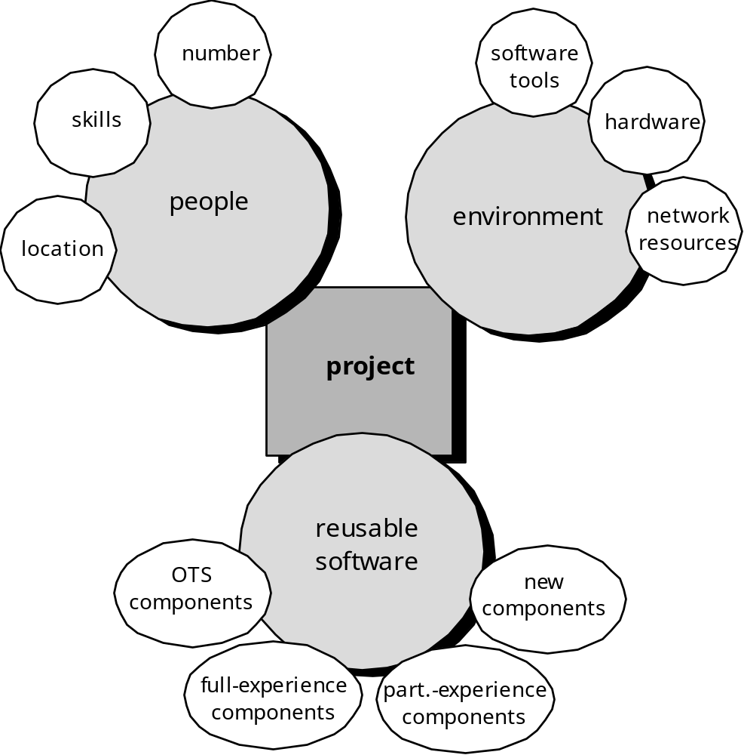
Resources
Three major resources
Four characteristics:
description
availability - licensing
time when the resource will be required
duration of time that resource will be applied
cost

Slide 14
Write it Down!
Project Scope
Estimates
Risks
Schedule
Control strategy
Software
Project
Plan

Slide 15
Estimation
Estimation of resources, cost, and schedule for a software engineering effort requires:
  experience
  access to good historical information (metrics)
  the courage to commit to quantitative predictions when qualitative information is all that exists
Estimation carries inherent risk and this risk leads to uncertainty

Slide 16

Project Estimation
Project scope must be understood
Elaboration (decomposition) is necessary
Historical metrics are very helpful
At least two different techniques should be used
Uncertainty is inherent in the process
Notes:
Software Engineering is a form of research
Experimenting with the unknown

Slide 17
Problem Decomposition
Sometimes called partitioning or problem elaboration
Once scope is defined …
  It is decomposed into constituent functions
    My bioinformatics work has had max 3 levels.
    AUGUSTUS, 8 levels of sub-functions
  It is decomposed into a set of problem classes
Decomposition process continues until all conceivable functions or problem classes have been defined.

Slide 18
System Structure
Interactions between subsystems
Boundary
Sub-system
Sub-system
Input
TRANSFORMATION
Output
Sub-system
Environment
Sub-system
Means of Regulation and Control
System: resources, continuity, measures of performance
System Context Diagram (SCD): establishes the information boundary between the system to be implemented and the environment in which the system is to operate.
Notes:
Look familiar?
Context level dataflow diagram – SIT 201
The boundary of a system is set by the specification.
The specification allows the system implementation to be hidden.
The preconditions identify the assumptions made by the system about the environment.
The postconditions identify the guarantees of the system.

Slide 19
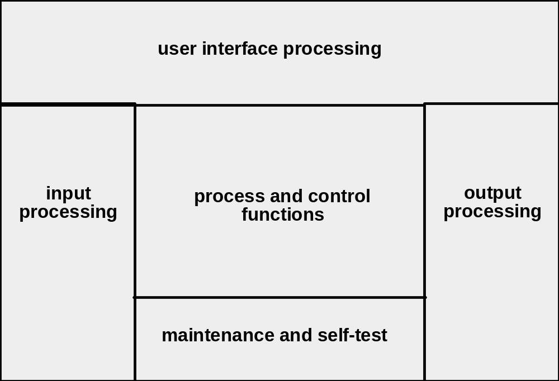
System Modeling
System model template

Slide 20
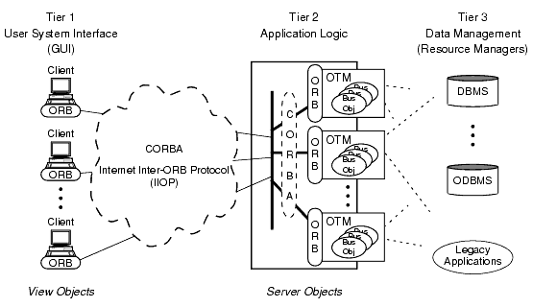
System Modeling

Slide 21
Functional Decomposition
Statement
of
Scope
functional
decomposition
Perform a Grammatical “parse”

Slide 22
Decomposition Example
Statement of Requirements: I require a software system which will allow me to enter a fixture of games for a season of football. As the games are played, I want to be able to enter results of these games. From these results, I want to compute a progressive premiership ladder.
System Structure?
Services and Functions offered?

Slide 23
Decomposition Example
Interface
Application
Draft:
Database/Local File
Domain: stand alone / network based, games and game results, users, ...
System Structure: e.g. above
Services and Functions: inputs games and game results, provides progressive premiership ladder.
Notes:
Level 1 DFD

Slide 24

Estimation Techniques
Past (similar) project experience
Conventional estimation techniques
  task breakdown and effort estimates
  size (e.g., FP) estimates
Empirical models
Automated tools

Slide 25
Estimation Accuracy
Predicated on …
  the degree to which the planner has properly estimated the size of the product to be built
  the ability to translate the size estimate into human effort, calendar time, and dollars (a function of the availability of reliable software metrics from past projects)
  the degree to which the project plan reflects the abilities of the software team
  the stability of product requirements and the environment that supports the software engineering effort.

Slide 26
Conventional Methods: LOC, FP
compute LOC/FP using estimates of information domain values
use historical data to build estimates for the project
LOC = Lines of Code
FP = Function Point

Slide 27
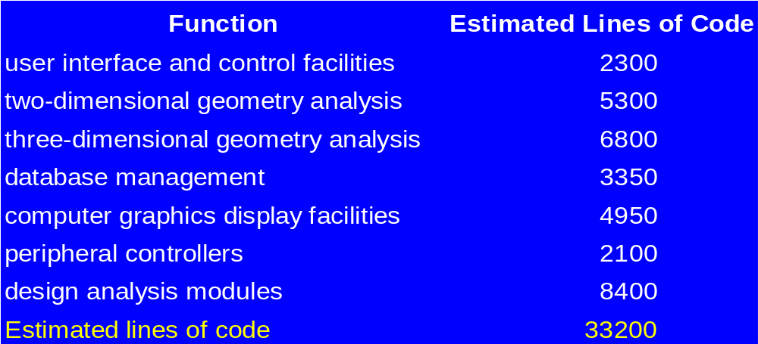
Example: LOC Approach
Historical data (given) is 620 LOC/pm.
Hence, the effort is 33200/620 = 54 person-months (pm)
At $50 per hour and work 160 hours per month, we have an
estimate of $432,000 (= 54x160x50)

Slide 28
Issues of LOC Approach
Programming language dependent.
Programming skill dependent, i.e. it penalizes well-designed but shorter programs.
Cannot easily accommodate non-procedural languages.
Requires a level of detail that may be difficult to achieve, i.e. the planner must estimate the LOC to be produced long before analysis and design have been completed.
Notes:
[Animated sequence start]

Slide 29
Summary
Objective of software planning:
  To provide a framework that enables the manager to make reasonable estimates of sources, cost, and schedule
Planning involves:
  Identifying software scope and determining feasibility
  Defining required resources
  Estimating cost and effort
  Scheduling (later session)
  Analyzing risk (later session)

Slide 30
Summary
Estimation is difficult and error prone
Estimation techniques
Decomposition of the product into sub-systems
One estimation method:
LOC (lines of code)

Slide 31
Summary
Questions?
Notes:
Many criteria to consider:
Time
Group members and their commitment
Money and resources
Requirements known?
Expectation of versions
Software lifespan

Slide 32
Readings
Pressman (6th edition):
  Chapter 23: Estimation for Software Projects
  Chapter 22: Process and Project Metrics
    especially Section 22.2 Software Measurement
  Chapter 21: Project Management Concepts

